Slide 1
Java Programming, 9e Chapter 6
Looping

Slide 2
Objectives
Describe the loop structure
Create while loops
Use shortcut arithmetic operators
Create for loops
Create do…while loops
Nest loops
Improve loop performance

Slide 3
Learning About the Loop Structure (1 of 3)
Loop
A structure that allows repeated execution of a block of statements
Loop body
A block of statements
Executed repeatedly
Iteration
One execution of any loop

Slide 4
Learning About the Loop Structure (2 of 3)
Three types of loops
while
The loop-controlling Boolean expression is the first statement
for
A concise format in which to execute loops
do…while
The loop-controlling Boolean expression is the last statement

Slide 5
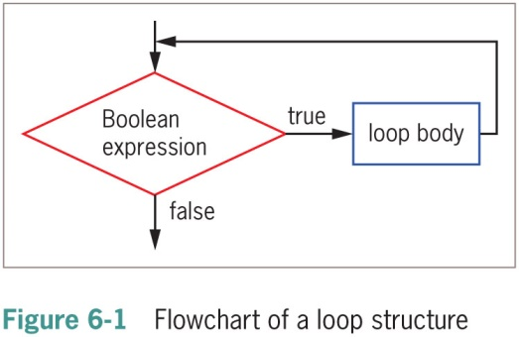
Learning About the Loop Structure (3 of 3)

Slide 6
Creating while Loops
while loop
Executes a body of statements continually
As long as the Boolean expression that controls entry into the loop continues to be true
Consists of:
The keyword while
Followed by a Boolean expression within parentheses
Followed by the body of the loop; can be a single statement or a block of statements surrounded by curly braces
Definite loop (counted loop): programmer knows exact number of iterations
Indefinite loop: programmer cannot predict number of iterations

Slide 7
Writing a Definite while Loop (1 of 6)
Initialize the loop control variable
The variable whose value determines whether loop execution continues
While the loop control variable does not pass a limiting value, the program continues to execute the body of the while loop

Slide 8
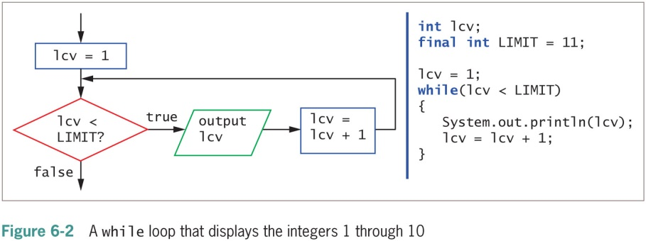
Writing a Definite while Loop (2 of 6)

Slide 9
Writing a Definite while Loop (3 of 6)
Write a definite loop (cont’d.)
The body of the loop must include a statement that alters the loop control variable
Infinite loop
A loop that never ends
Can result from a mistake in the while loop
Do not write intentionally

Slide 10
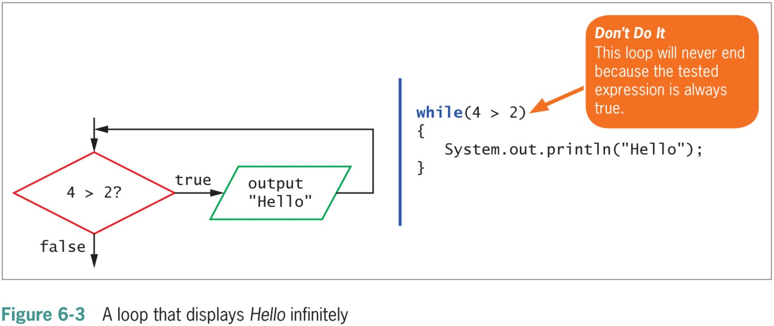
Writing a Definite while Loop (4 of 6)

Slide 11
Writing a Definite while Loop (5 of 6)
Suspect an infinite loop when:
The same output is displayed repeatedly
The screen remains idle for an extended period of time
To exit an infinite loop, press and hold Ctrl, then press C or Break

Slide 12
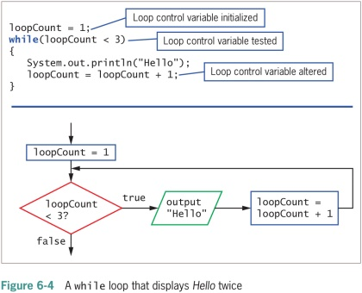
Writing a Definite while Loop (6 of 6)

Slide 13
Pitfall: Failing to Alter the Loop Control Variable Within the Loop Body (1 of 2)
Prevent the while loop from executing infinitely
The named loop control variable is initialized to a starting value
The loop control variable is tested in the while statement
If the test expression is true, the body of the while statement takes action
Alters the value of the loop control variable
The test of the while statement must eventually evaluate to false

Slide 14
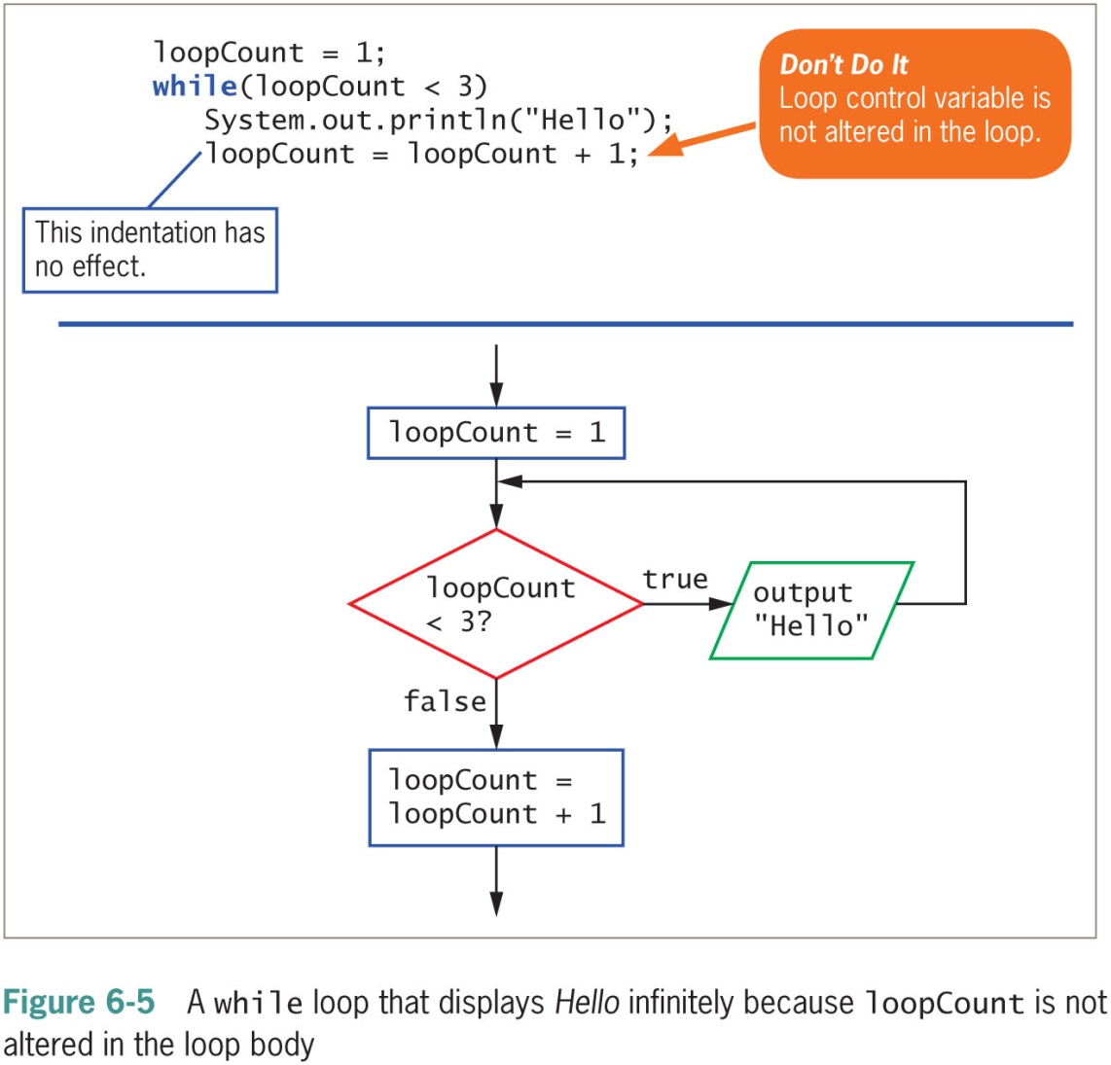
Pitfall: Failing to Alter the Loop Control Variable Within the Loop Body (2 of 2)

Slide 15
Pitfall: Unintentionally Creating a Loop with an Empty Body (1 of 2)
Loop control variable
A variable that is altered and stored with a new value
loopCount = loopCount + 1
The equal sign assigns a value to the variable on the left
The variable should be altered within the body of the loop
Empty body
A body with no statements
Caused by misplaced semicolons

Slide 16
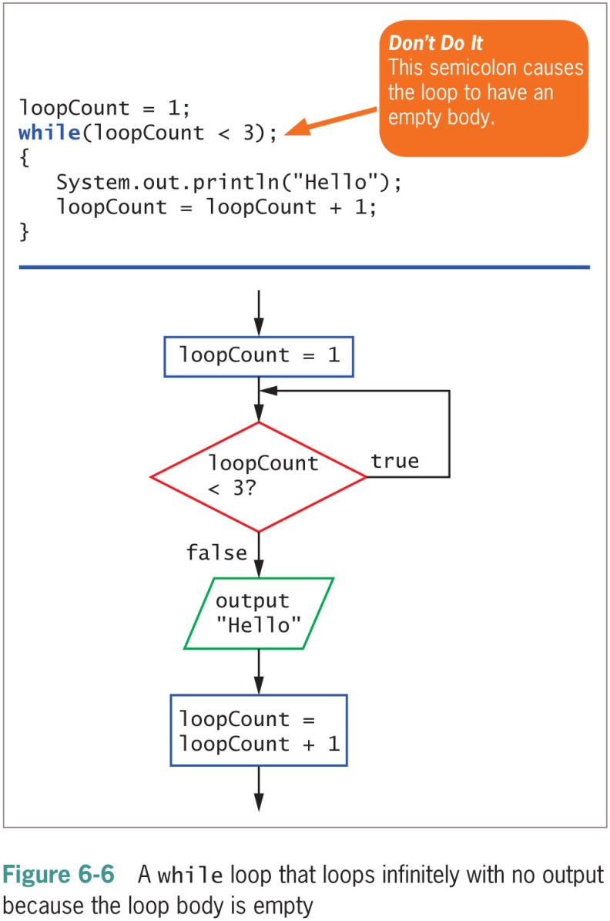
Pitfall: Unintentionally Creating a Loop with an Empty Body (2 of 2)

Slide 17
Altering a Definite Loop’s Control Variable (1 of 2)
Incrementing the variable
Alter the value of the loop control variable by adding 1
Decrementing the variable
Subtract 1 from the loop control variable
Clearest and best method
Start the loop control variable at 0 or 1
Increment by 1 each time through the loop
Stop when the loop control variable reaches the limit

Slide 18
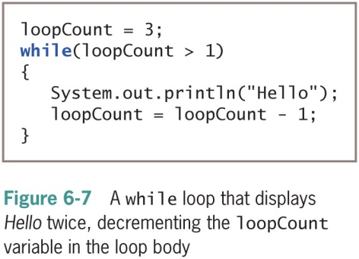
Altering a Definite Loop’s Control Variable (2 of 2)

Slide 19
Writing an Indefinite while Loop (1 of 2)
Event-controlled loop
Altered by user input
Controlled by the user
Executed any number of times

Slide 20
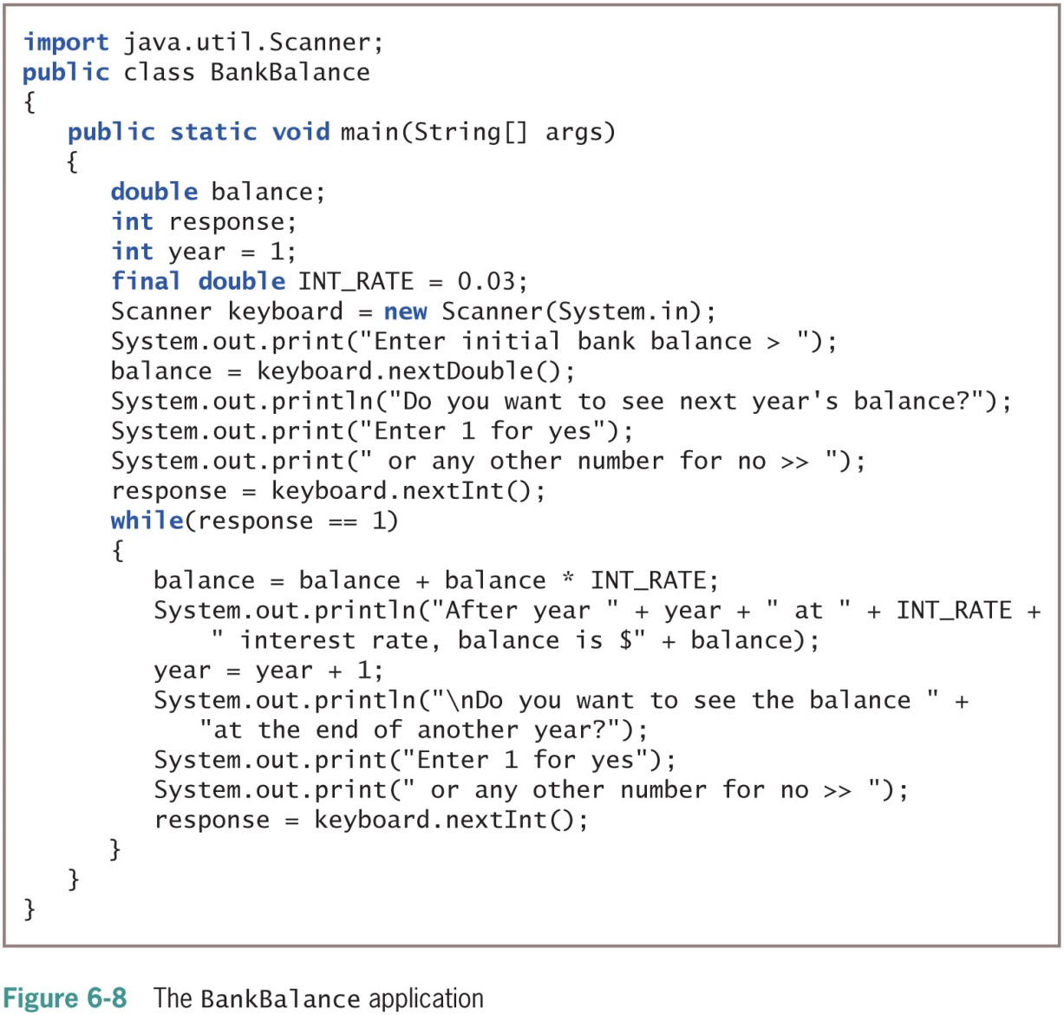
Writing an Indefinite while Loop (2 of 2)

Slide 21
Validating Data (1 of 2)
Validating data
Ensure a value falls within a specified range
Use indefinite loops to validate input data
If a user enters incorrect data, the loop repeats
Priming read (priming input)
Input retrieved before the loop is entered
Within a loop, the last statement retrieves the next input value and checks the value before the next entrance of the loop

Slide 22
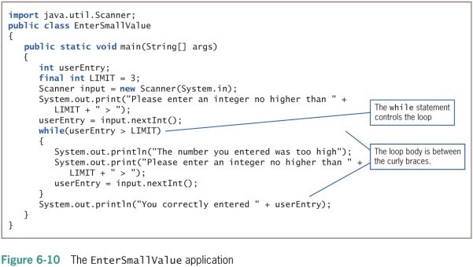
Validating Data (2 of 2)

Slide 23
Using Shortcut Arithmetic Operators (1 of 5)
Accumulating
Repeatedly increasing a value by some amount
Java provides shortcuts for incrementing and accumulating
+= add and assign operator
-= subtract and assign operator
*= multiply and assign operator
/= divide and assign operator
%= remainder and assign operator

Slide 24
Using Shortcut Arithmetic Operators (2 of 5)
Prefix increment operator and postfix increment operator
++someValue, someValue++
Use only with variables
Unary operators
Use with one value
Increase a variable’s value by 1
No difference between operators (unless other operations are in the same expression)

Slide 25
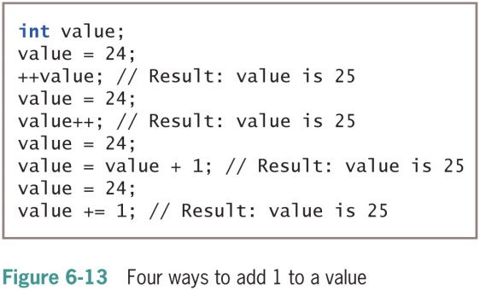
Using Shortcut Arithmetic Operators (3 of 5)

Slide 26
Using Shortcut Arithmetic Operators (4 of 5)
Prefix increment operator and postfix increment operator (cont’d.)
Prefix ++
The result is calculated and stored
Then the variable is used
Postfix ++
The variable is used
Then the result is calculated and stored
Prefix and postfix decrement operators
--someValue
someValue--
Similar logic to increment operators

Slide 27
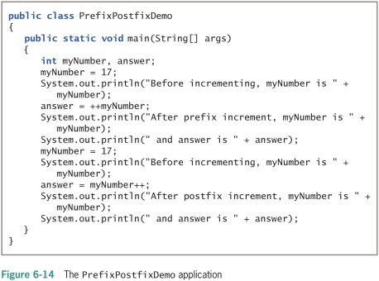
Using Shortcut Arithmetic Operators (5 of 5)

Slide 28
Creating a for Loop (1 of 4)
for loop
Used when a definite number of loop iterations is required
One convenient statement indicates:
The starting value for the loop control variable
The test condition that controls loop entry
The expression that alters the loop control variable

Slide 29
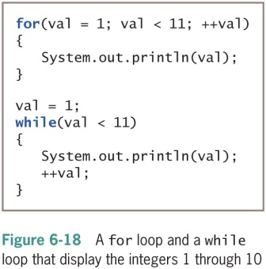
Creating a for Loop (2 of 4)

Slide 30
Creating a for Loop (3 of 4)
Unconventional for loops
Initialization of more than one variable
Place commas between separate statements
Performance of more than one test using AND or OR operators
Decrementing or performance of some other task
Altering more than one value
You can leave one or more portions of a for loop empty
Two semicolons are still required as placeholders

Slide 31
Creating a for Loop (4 of 4)
Use the same loop control variable in all three parts of a for statement
To pause a program:
Use the for loop that contains no body (do-nothing loop)
for(x = 0; x < 100000; ++x);
Or use the built-in sleep() method

Slide 32
Learning How and When to Use a do…while Loop (1 of 3)
do…while loop
As a pretest loop:
Checks the value of the loop control variable before loop body
As a posttest loop
Checks the value of the loop control variable
At the bottom of the loop
After one repetition has occurred
Performs a task at least one time
You are never required to use this type of loop
Use curly braces to block the statement
Even with a single statement

Slide 33
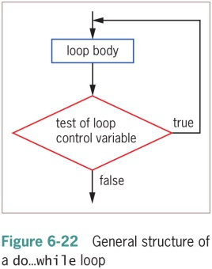
Learning How and When to Use a do…while Loop (2 of 3)

Slide 34
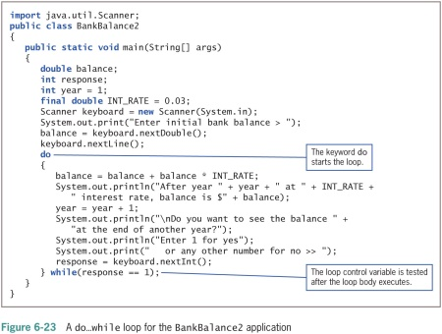
Learning How and When to Use a do…while Loop (3 of 3)

Slide 35
Learning About Nested Loops (1 of 2)
Inner loop and outer loop
An inner loop must be entirely contained in an outer loop
Loops can never overlap
To print three mailing labels for each of 20 customers:
for(customer = 1; customer <= 20; ++customer)
for(color = 1; color <= 3; ++color)
outputLabel ();

Slide 36
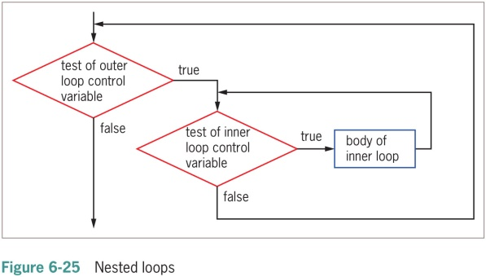
Learning About Nested Loops (2 of 2)

Slide 37
Improving Loop Performance
Make sure a loop does not include unnecessary operations or statements
Consider the order of evaluation for short-circuit operators
Make comparisons to zero (0)
Employ loop fusion to combine loops

Slide 38
Avoiding Unnecessary Operations
Do not use unnecessary operations or statements:
Within a loop’s tested expression
Within the loop body
Avoid:
while (x < a + b)
// loop body
Instead use:
int sum = a + b;
while(x < sum)
// loop body

Slide 39
Considering the Order of Evaluation of Short-Circuit Operators
Short-circuit evaluation
Each part of an AND or an OR expression is evaluated only as much as necessary to determine the value of the expression
Important to consider the number of evaluations that take place
When a loop might execute many times

Slide 40
Comparing to Zero (1 of2)
Making a comparison to zero (0) is faster than making a comparison to any other value
To improve loop performance, compare the loop control variable to zero (0)
Do-nothing loop
Performs no actions other than looping

Slide 41
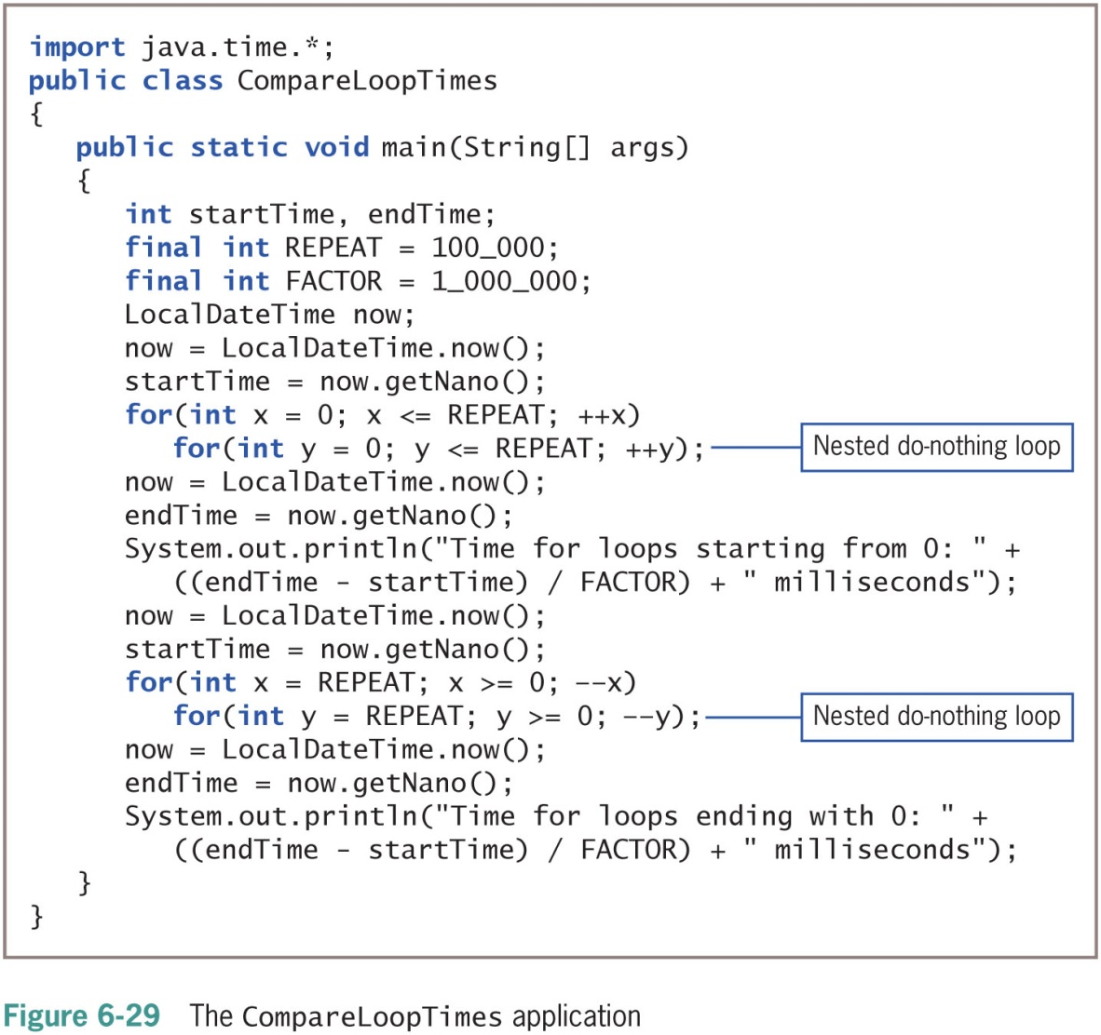
Comparing to Zero (2 of 2)

Slide 42
Employing Loop Fusion
Loop fusion
A technique of combining two loops into one
Will not work in every situation

Slide 43
Don’t Do It
Don’t insert a semicolon at the end of a while clause
Don’t forget to block multiple statements that should execute in a loop
Don’t make the mistake of checking for invalid data using a decision instead of a loop
Don’t ignore subtleties in the boundaries used to stop loop performance
Don’t repeat steps within a loop that could just as well be placed outside the loop

Slide 44
Summary (1 of 3)
The loop structure allows repeated execution of a block of statements
Infinite loop
Definite loop
Nest loop
You must change the loop control variable within the looping structure
Use the while loop to execute statements while some condition is true

Slide 45
Summary (2 of 3)
Execute the while loop
Initialize the loop control variable, test in the while statement, and alter the loop control variable
Prefix ++ and postfix ++
Increase a variable’s value by 1
The variable is used
The result is calculated and stored
Unary operators
Use with one value

Slide 46
Summary (3 of 3)
Binary operators
Operate on two values
Shortcut operators +=, -=, *=, and /=
Perform operations and assign the result in one step
for loop
Initializes, tests, and increments in one statement
do…while loop
Tests a Boolean expression after one repetition
Improve loop performance
Do not include unnecessary operations or statements

